Slide 1


Assessing the Effects of Storm Surge Barriers on the Hudson River Estuary
Project Scoping Session
PI Philip Orton, Stevens Institute of Technology, (201) 216-8095, philip.orton@stevens.edu
Bennett Brooks (Coordination Lead), Consensus Building Institute, bbrooks@cbi.org
Kristin Marcell, New York State DEC, Hudson River Estuary Program, and Cornell University Water Resources Institute
Sarah Fernald, NOAA Hudson River National Estuarine Research Reserve and New York State Department of Environmental Conservation (NYS DEC)

Slide 2
Scoping Session Purpose
Provide an update on the Harbor and Tributaries Focus Area Feasibility (HAT) Study
Take stock of current knowledge of estuary effects of gated storm surge barrier systems
Learn of the broad range of stakeholder concerns and interests related to the potential environmental effects of storm surge barriers on the Hudson River Estuary
Get input on the draft Scope of Work, including scientific analyses and scientific workshop(s)
Identify potential future prospects and funding for deeper science and a broader involvement from the research community

Slide 3
Introduction/Welcome
Welcome remarks (Philip Orton, Stevens Institute)
Agenda review and session ground rules (Bennett Brooks, Consensus Building Institute)
Scoping Session participant self-introductions
Distributed Files (Handouts / Friday morning email):
Today’s agenda
Updated project description/fact sheet
Scoping Session description
Draft Scope of Work
Project Advisory Committee (PAC) description (only by email)
Notes:
o make sure to speak with appreciation about the project team
o speak from the heart about scientists and local institutional knowledge influencing Corps studies

Slide 4
Scoping Session Agenda
Introduction / welcome
Project overview and discussion (Orton)
Current knowledge of barrier effects on components of estuary health (Orton)
Update of the HAT Study (Wisemiller)
Lunch
Stakeholder interests and concerns
Near-Term analyses within this study
Near-Term (Summer) scientific workshops
Research funding needs and opportunities
Wrap-up, next steps

Slide 5
Scoping Session Ground Rules
What we ask of each other
  Contribute, but share time
  Learn from each other, integrate across ideas, explain scientific basis for concerns
  Be mindful of session purpose
    Informed feedback, not decision-making
    Seeking to understand potential effects, not debating merits of surge barriers
    Conversation informs updated scope of work
Session Mechanics
  Planning team to support discussion, keep us on track
  Mix of plenary and small group conversations
  Cell phones off, placards up
  Lunch provided; no other set breaks

Slide 6
Scoping Session Ground Rules

Slide 7
Project Overview and Discussion
Review of project purpose, approach, timeline, spatial coverage, intended work product, PAC composition and today’s invitees (10 minutes)
Discussion: Feedback on project approach and plans

Slide 8
Project Overview
Project team:
Philip Orton, Bennett Brooks (Coordination Lead), Kristin Marcell, Sarah Fernald
Funding:
NOAA National Estuarine Research Reserve System (NERRS) Science Collaborative
→ Collaborative and End-User driven from start-to-finish
Project Type:
One-year “Catalyst” – Targeted investment for advancing collaborative science
Goals:
  (1) To facilitate development of a collaborative research agenda that can help interested parties better understand potential barrier effects on nearby estuaries
  (2) To undertake targeted research in close collaboration and with information‐sharing among scientists and key end‐users such as the U.S. Army Corps of Engineers and its partners NY State, NYC and NJ

Slide 9
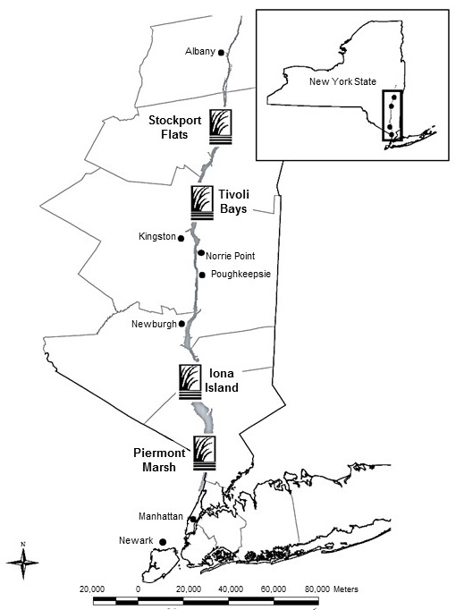
Assessing the Effects of Storm Surge Barriers on the Hudson River Estuary
FOCUS:
The project was originally intended to focus on the physical and ecological effects of gated storm surge barriers on the Hudson River estuary and its habitats and ecosystems (entire tidal Hudson up to Troy and NY/NJ Harbor).
Some adjustment is possible, particularly if it helps us better contribute to improving the HATS study.
HR-NERR Sites

Slide 10
Project Advisory Committee Description
The Project Advisory Committee (PAC) of this NERRS-SC-funded project is a group of about 15 members that serves as a sounding board for the project scope and design throughout the project. The PAC’s main purpose is to provide ongoing guidance to ensure the project is relevant, effective and credible to both decision-makers and the broader stakeholder community.
To that end, the Project Team identified a bounded set of individuals and agencies to serve on the PAC who collectively represent: (1) city, state and federal decision-makers on the HATS study; (2) representatives from the Barrier Benefits and Impacts (BBI) Workgroup that preceded this effort; and (3) scientists with a detailed specific knowledge of the physical oceanographic or engineering aspects of surge barriers, as well as their estuary effects.
While the Project Team is solely responsible for project work and outcomes, PAC input will be essential in helping identify consensus-supported approaches for a study that is likely to be of great interest to a wide range of stakeholders. The PAC will convene via webinar about four times over the coming project’s one-year duration (October 15, 2018 to October 14, 2019). Specifically, the PAC will provide input to the Project Team on the project approach, scientific analyses, and scientific workshops.

Slide 11
Project Advisory Committee
Hudson River Foundation
NJ DEP Office of Engineering and Construction
NY-NJ Harbor Estuary Program
NYC Office of Recovery and Resiliency
NYS-Department of Environmental Conservation
NYS-Department of State
Regional Planning Association
Science and Resilience Institute at Jamaica Bay
Stony Brook University
USACE-NY
USACE-NY, Environmental Analysis Branch
Project team
  Stevens Institute of Technology
  NYS-DEC Hudson River Estuary Program
  Hudson River National Estuarine Research Reserve
  Consensus Building Institute

Slide 12
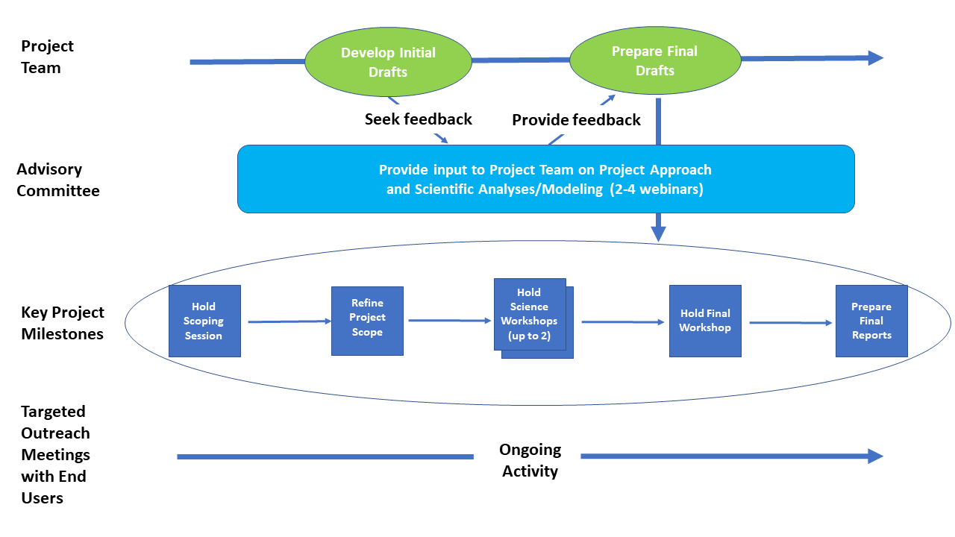
Project Overview
March
May-August
September

Slide 13
Deliverables and Due Dates
Deliverable | Due Date
Revised Scope of Work | draft in March, final in April
Scientific workshop report(s) | drafts within two weeks, final September
Technical report on analyses + modeling | draft August, final October
Proposals for additional funding | ongoing
Scope of Future Work | draft September, final October
Project final report to NOAA | October

Slide 14
Scoping Session Approach
Scoping Session attendees have been invited based on meeting the following recruitment criteria:
  Member of the PAC and/or relevant expertise in disciplines that include coastal storm risk, coastal storm risk management approaches or environmental science (physical, chemical, ecological) in NY/NY Harbor, the Hudson River estuary or sub-estuaries
  Offer a unique geographical or otherwise critical or necessary perspectives to the project
  Willingness to adhere to widely accepted methods of scientific inquiry, engage objectively and collaboratively, and consider a variety of possible outcomes to manage coastal storm risk in the study area
In general, the Project Team is limiting participation from each organization to ensure the Scoping Session is small enough to foster effective discussions

Slide 15
Questions and feedback on project approach and plans

Slide 16
Current Knowledge of Barrier Effects on Components of Estuary Health
Part I: The Hudson River estuary environment
Part II: Physical effects of gated storm surge barriers on partially mixed estuaries

Slide 17
Partially-mixed estuary
Estuarine circulation dominates exchange with the coastal ocean
→ length of salinity intrusion, residence time of nutrients, contaminants, etc.
→ tidal amplitude affects estuarine circulation and stratification non-linearly
Tides
River
0 psu
Ocean
32 psu
Stratification (~ U_{t}⁻³)
and mixing
Estuarine circulation (~ U_{t}⁻¹)

Slide 18
Partially-mixed estuary
Estuarine circulation dominates exchange with the coastal ocean
→ length of salinity intrusion, residence time of nutrients, contaminants, etc.
→ tidal amplitude affects estuarine circulation and stratification non-linearly*
Neap tides
River
0 psu
Ocean
32 psu
Stratification (~ U_{t}⁻³)
and mixing
*details depend on bathymetry and other factors
Estuarine circulation (~ U_{t}⁻¹)
Spring tides
River discharge variability another leading factor
Ocean
32 psu

Slide 19
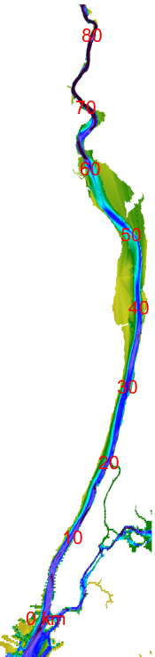
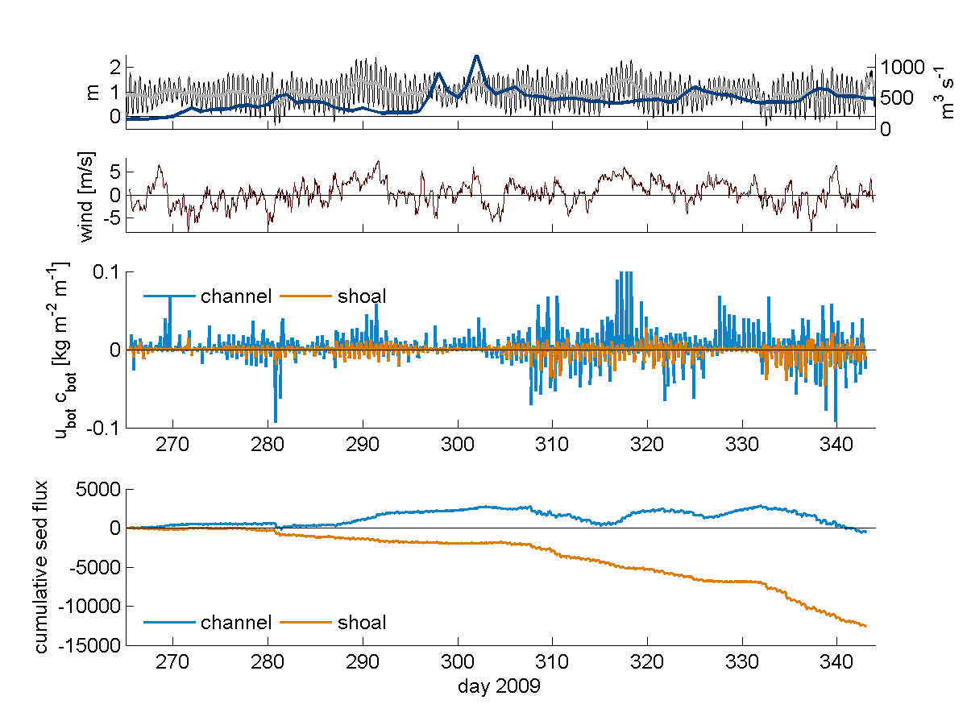
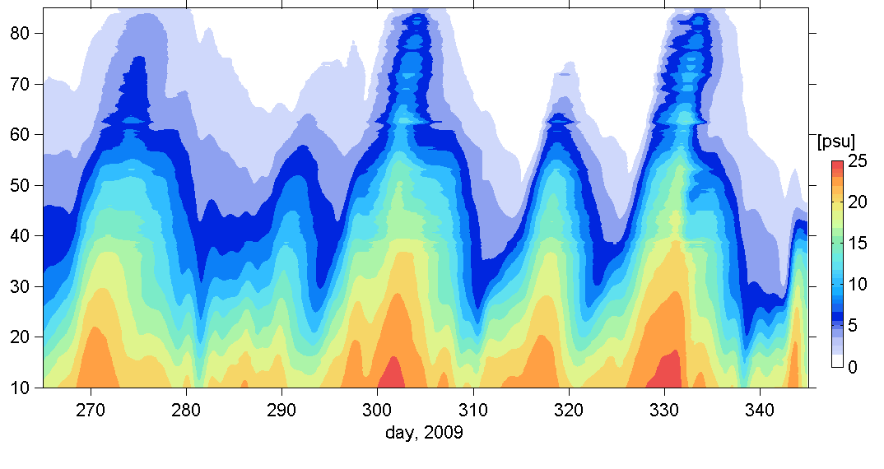
Salinity intrusion in the Hudson
Salinity moves landward during neap tides, retreats seaward during spring tides
→ During neaps stratification increases, residence times increase
discharge and tides
bottom salinity in the Hudson
Distance from Battery (km)
NEAP
NEAP
NEAP
NEAP
NEAP
model results, Fall 2009

Slide 20
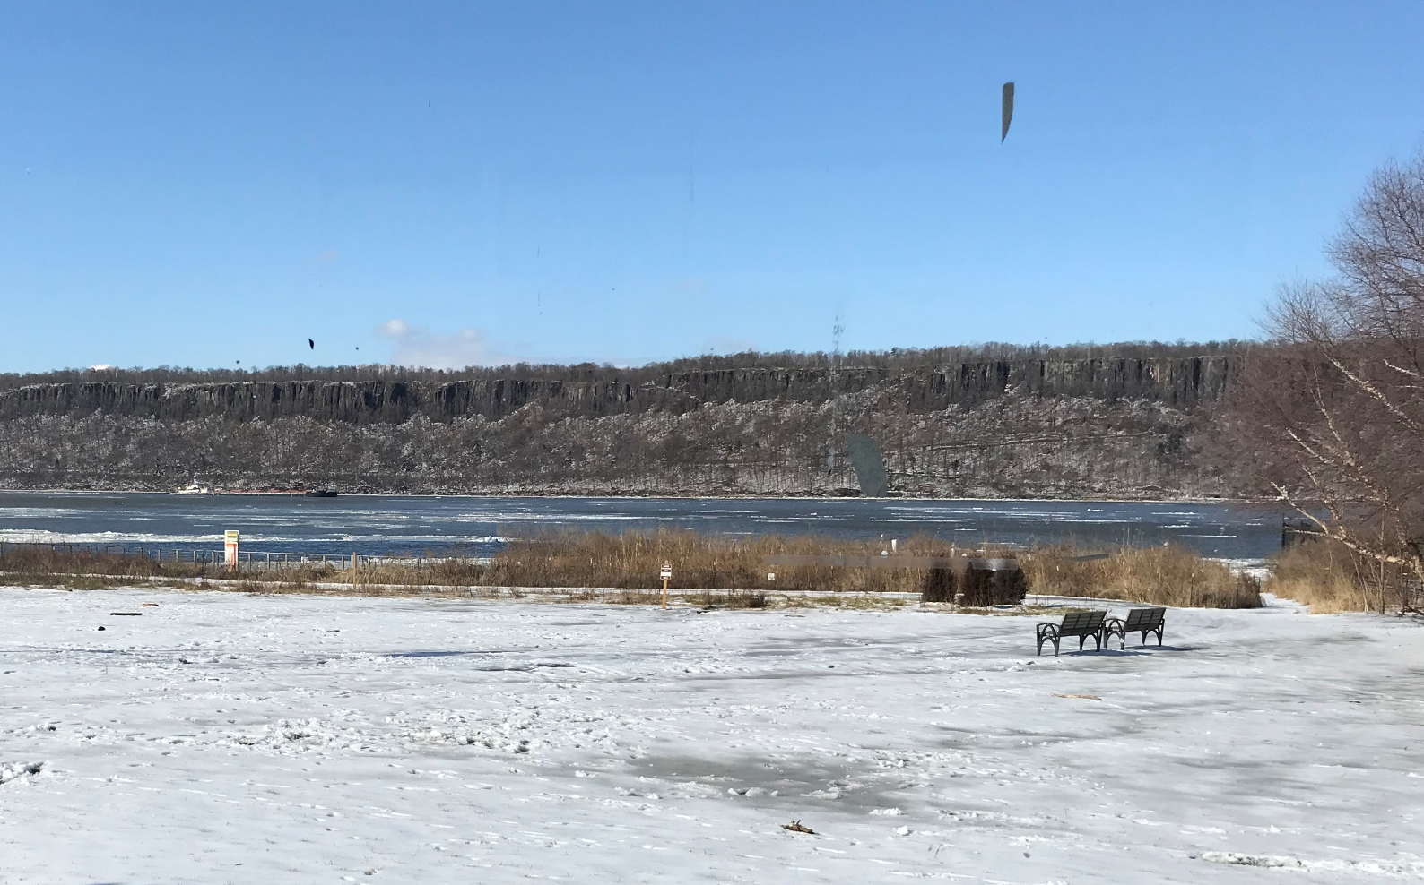
Variability also Defines the Hudson
Salinity
Temperature
Sources of variability:
  neap-spring tide
  seasonal freshwater
  seasonal thermal, ice
Is there an important role for storm-surge driven variability too?

Slide 21
The Hudson River Estuary Environment:
Other Characteristics
Geomorphology – “sediment-filled fjord” dominated by channel flow, side bays/ islands, but with manmade berm-fronted areas
Eutrophic – high levels of nutrients
Dissolved oxygen – few problems in recent decades in open Hudson waters
Turbidity – a moderately turbidity system – photosynthesis is often light limited
Flora - freshwater, brackish, submerged or emergent vegetation (spartina, phragmites, water chestnut)
Fauna - microorganisms, phytophankton, zooplankton, and so on up the food chain to fish, shellfish, eels and birds …

Slide 22
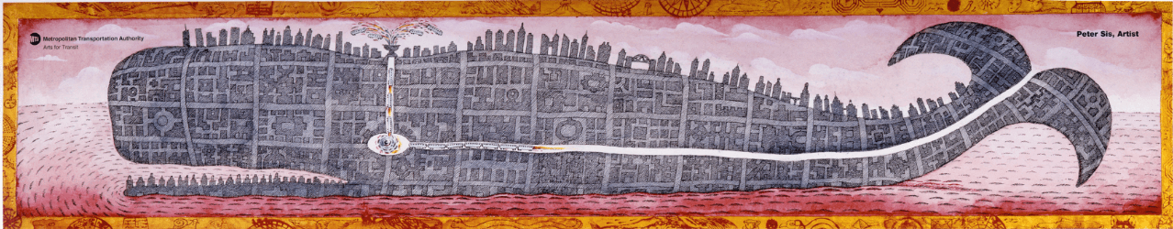
… and now, even whales!

Slide 23
First cut for discussion:
Key issues for environmental health and human use
oxygenation
circulation, flushing – due to high nutrient inputs, flushing is critical
stratification
fish migration, habitat (e.g. velocity, temperature)
marine mammals
zooplankton/larval fish
oysters
tidal marshes
submerged aquatic vegetation
turbidity
erosion/deposition balance
persistent pollutants (e.g. PCBs, metals)
microplastics, floatables/garbage
recreational water quality
drinking water quality
physical appearance (e.g. tides, currents, ice, seasonal freshet flooding)
commerce – shipping, cooling capacity for power plants
flood risk

Slide 24



Part II:
Physical effects of gated storm surge barriers on partially mixed estuaries
Philip Orton
Stevens Institute of Technology
With contributions from David Ralston, Woods Hole Oceanographic Institution

Slide 25
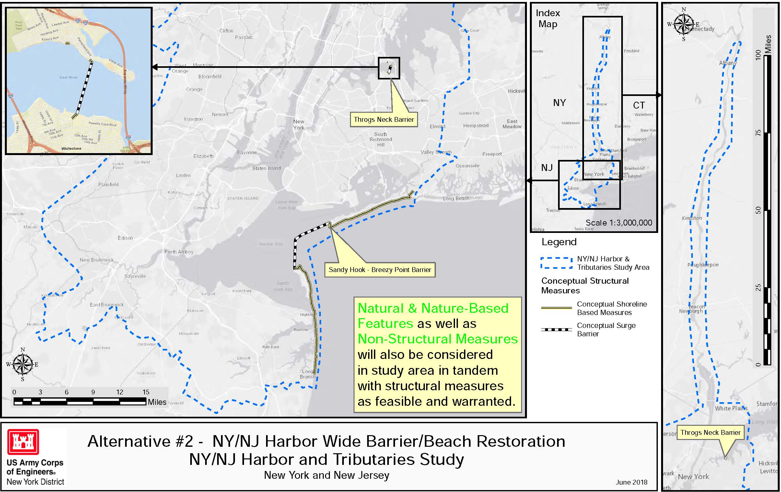
Hudson River
Notes:
Bryce

Slide 26
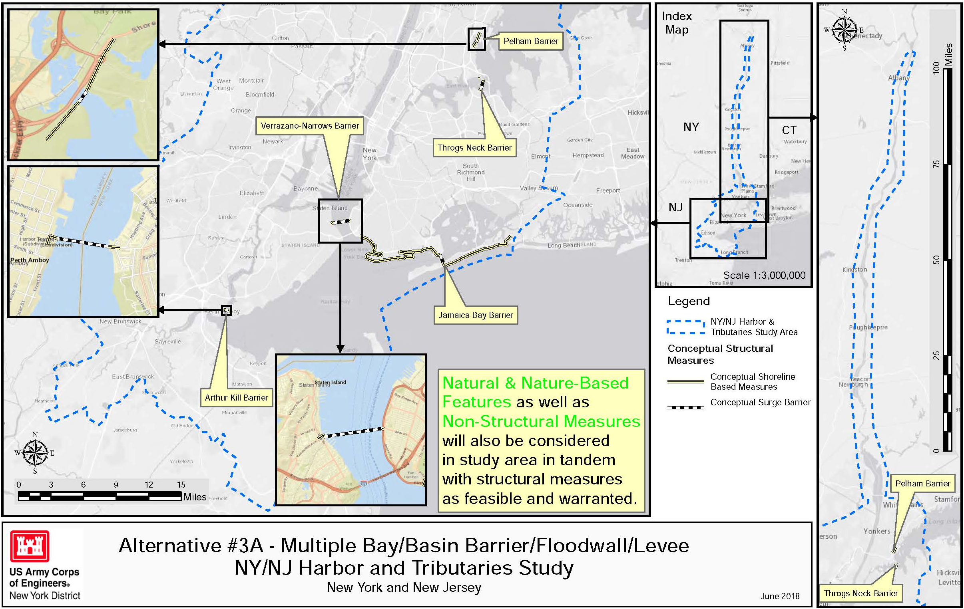
Hudson River
Notes:
Bryce

Slide 27
Physical Estuary Effects of Surge Barriers
Gates are closed during storm surge conditions that exceed some management threshold. Gate closure …
  eliminates tidal and surge forcing
  traps river forcing
  stops flooding!
  … but estuary circulation and stratification effects are more complex, not studied as much
Even when the surge gates are open, fixed infrastructure remains in place and partially obstructs the waterway

Slide 28
Physical Estuary Effects of Open Surge Barriers
(results from Orton and Ralston study, summer 2018)
The Hudson preliminary modeling and past studies provided consistent qualitative conclusions on the physical estuary effects of surge barriers
The degree of effects can be small or large – depends on openness of barrier
When a barrier system partially restricts estuary-ocean exchange
  It leads to stronger tidal currents and mixing near the barrier gate openings
  Elsewhere, on spring tides it causes reductions in tides, currents, mixing, and increases in stratification and salt intrusion
  For a partially mixed estuary, these changes lead to longer residence times at most locations
  However, for standing-wave estuaries or tide straits, different results may arise

Slide 29
Preliminary Modeling of Estuary Effects: Experimental Setup (Summer 2018 research)
We applied three existing well-tested models of the region and estuary
  Stevens ECOM/NYHOPS, Woods Hole’s ROMS and FEMA’s ADCIRC
  Tide simulations with mean streamflow
Why “preliminary”? To be certain you accurately simulate flows through tide gates will require developing one or more custom model grids
  If the main navigation gate is O(500) meters wide, you need O(50) meter resolution
  If flow gates are O(50) meters wide, you need O(5) meter resolution
We studied hypothetical gated storm surge barriers between Sandy Hook and Rockaway Peninsula – Throgs Neck was left open
Gated Flow Area is the relative (%) openness to flow – estimated here using cross-sectional area (CSA) across the inlet: GFA = CSA_{opengates} / CSA_{inlet}

Slide 30
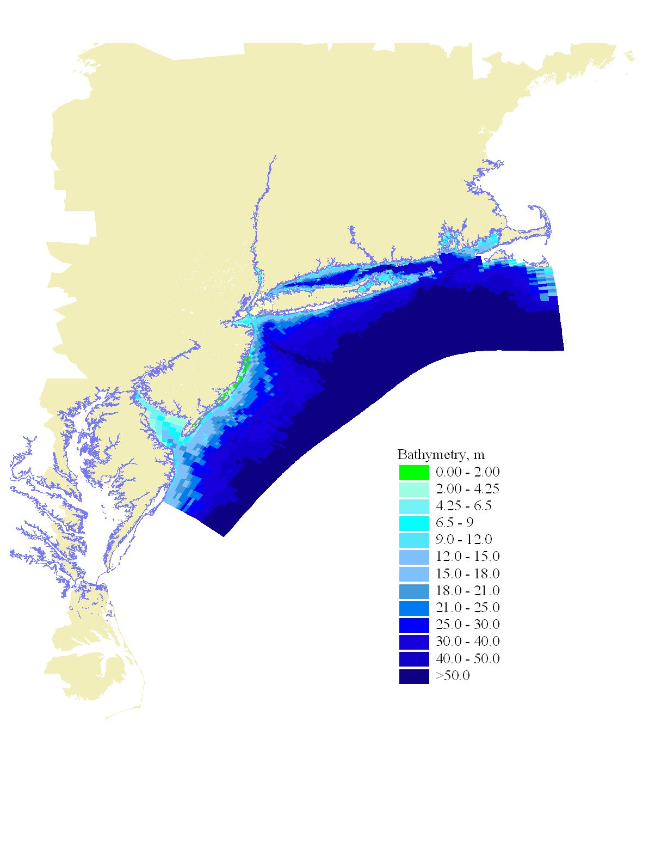
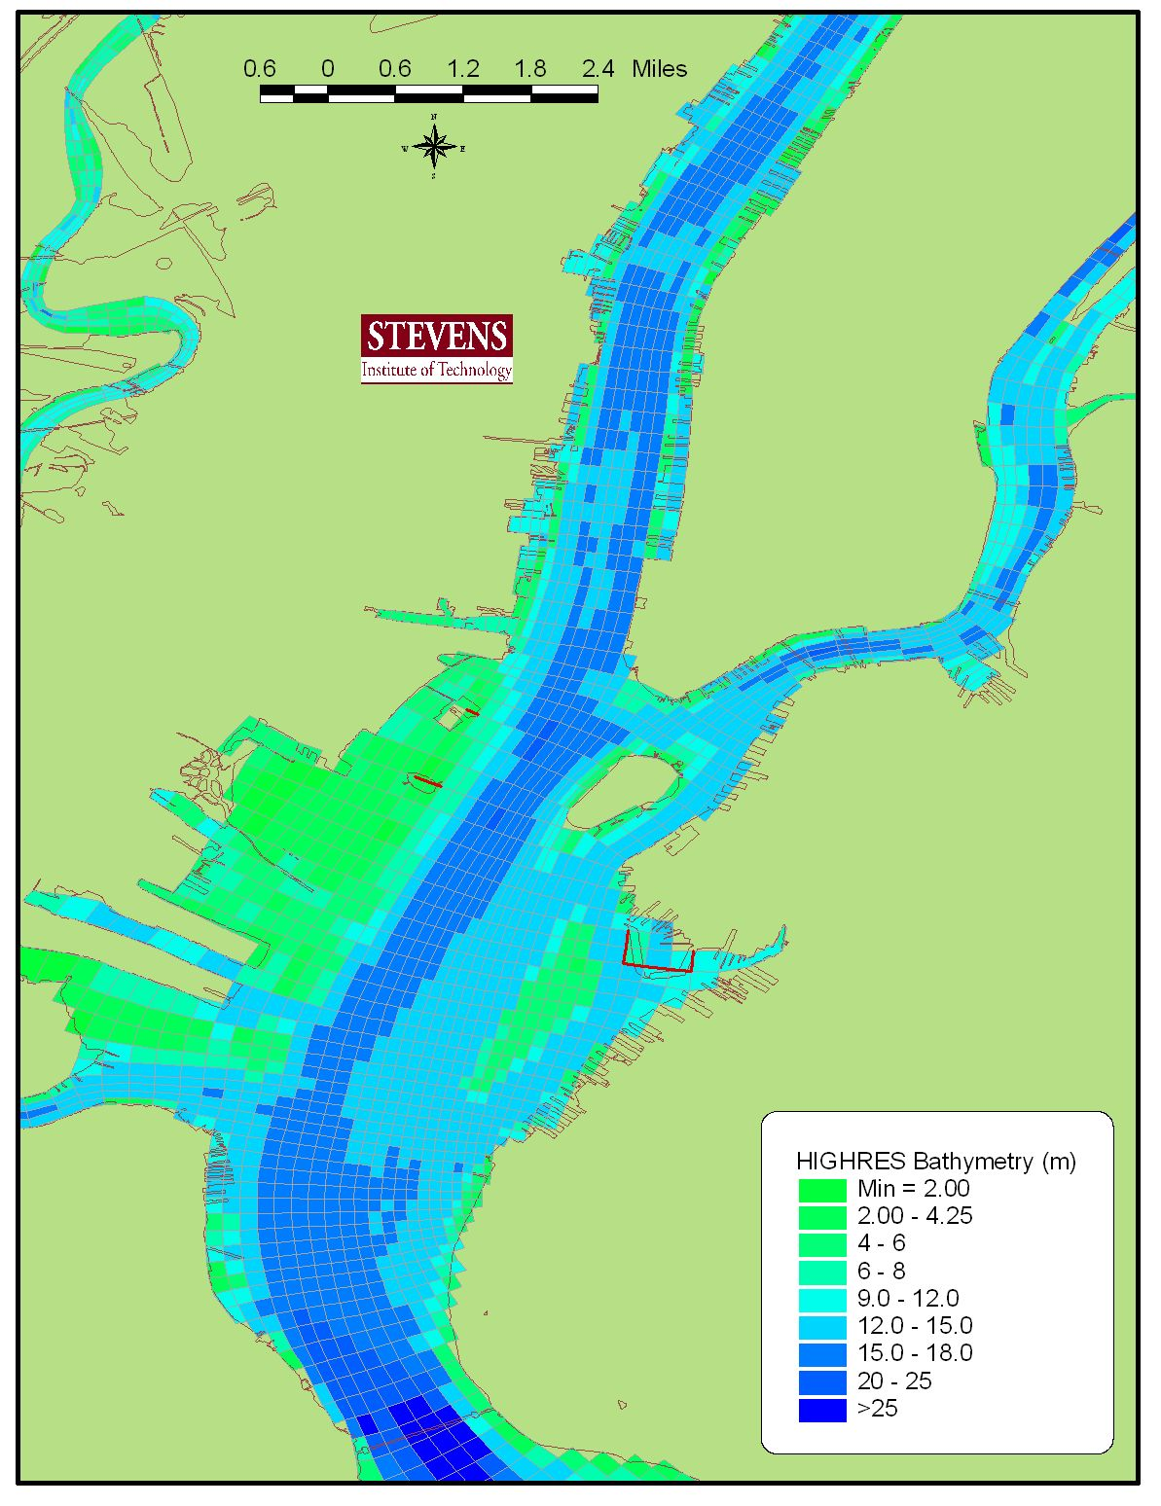
Hydrodynamic MODEL: Stevens ECOM (sECOM)
The GRID/DOMAIN: NYHOPS
Albany
West Point
Battery
Battery
NY Harbor Observing and Prediction System
Daily forecasts at http://stevens.edu/NYHOPS
Stevens Flood Advisory System http://stevens.edu/SFAS
High-resolution model grid (147x452 x10 vertical). 150,680 water cells
  Freshwater: Gaged major tribs (93), estimated minor tribs (146), WWTP (241), rain-on-water
Notes:
All along the Hudson you have about 10 cells across the channel, as well as 10 cells in the vertical to resolve vertical variations

Slide 31
Control Grid: sECOM/NYHOPS (GFA 100%)
NYHOPS model grid/domain
Total cross-sectional area at inlet between Rockaways and Sandy Hook in NYHOPS is 80000 m².

Slide 32
sECOM/NYHOPS: GFA 62%
10m high blockages to cells in ungated, closed areas of barrier.

Slide 33
sECOM/NYHOPS : GFA 44%
10m high blockages to cells in ungated, closed areas of barrier.

Slide 34
Tides: Control (GFA 100%), GFA 62% and 34%
Northern Manhattan Site
GFA 62%
GFA 34%
Control tide range over final tidal month was 1.35 m.
GFA 62% - tide range is 1.28
→ 95% tide range conveyance
GFA 34% - tide range is 1.12 m
→ 83% tide range conveyance
NEAP
SPRING

Slide 35
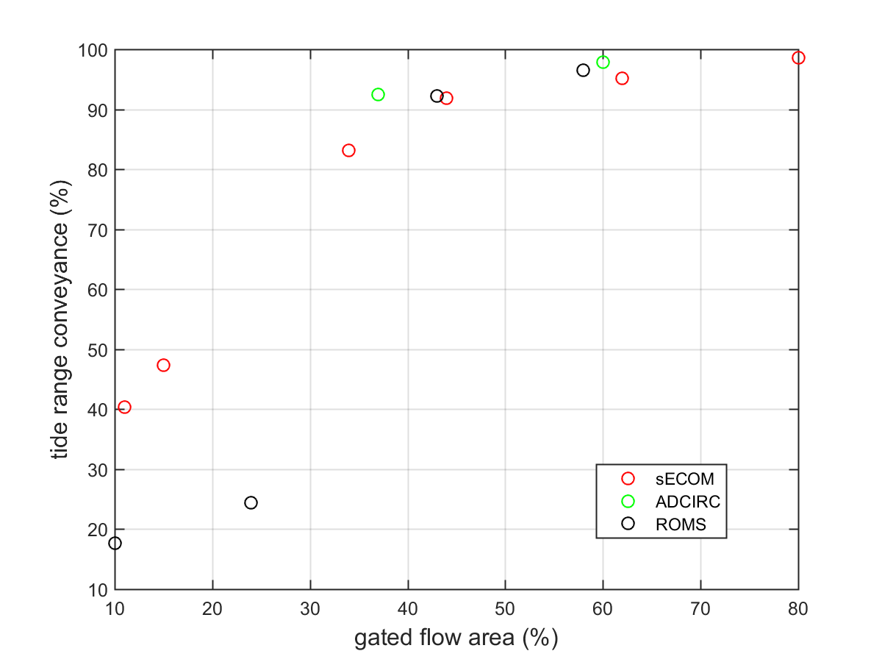
GFA vs Tide Conveyance
All plotted points are for Northern Manhattan site
Conveyance is 100 x ratio:
tide range in experiment
tide range in control

Slide 36
Partially-mixed estuary
Estuarine circulation dominates exchange with the coastal ocean
→ length of salinity intrusion, residence time of nutrients, contaminants, etc.
→ tidal amplitude affects estuarine circulation and stratification non-linearly*
Neap tides
River
0 psu
Ocean
32 psu
Stratification (~ U_{t}⁻³)
and mixing
*details depend on bathymetry and other factors
Estuarine circulation (~ U_{t}⁻¹)
Spring tides
River discharge variability another leading factor
Ocean
32 psu

Slide 37
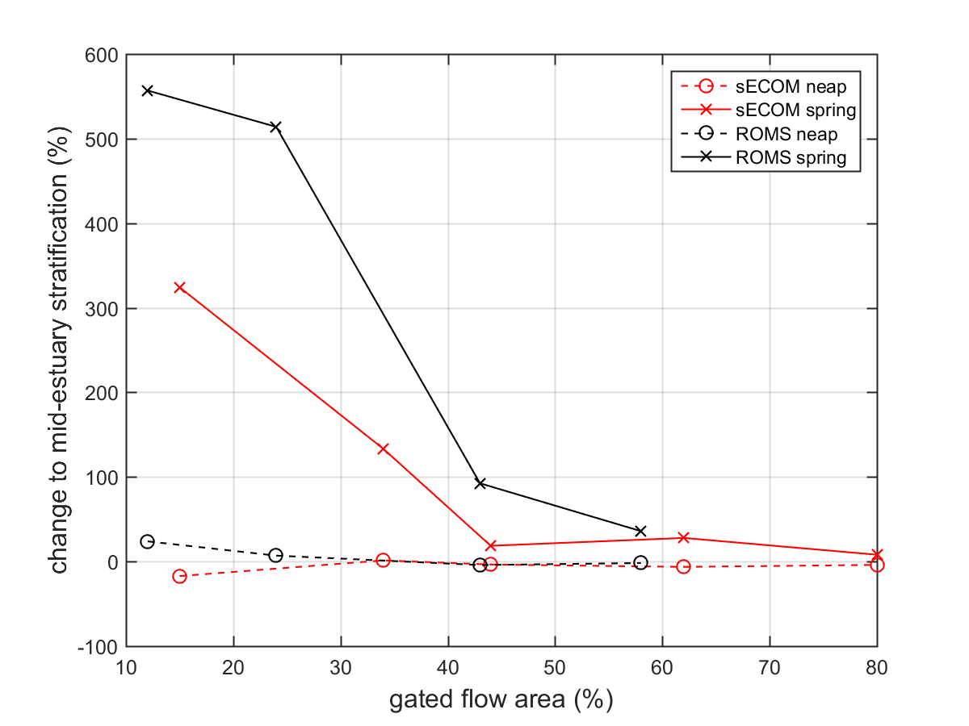
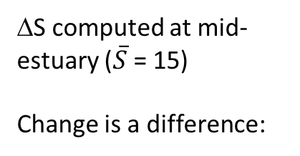

GFA vs ΔS (salt stratification)
ΔS computed at mid-estuary ($\overline{S}$ = 15)
Change is a difference:
$100\left(\frac{{∆S}_{experiment}}{{∆S}_{control}}\right)$ - 100

Slide 38
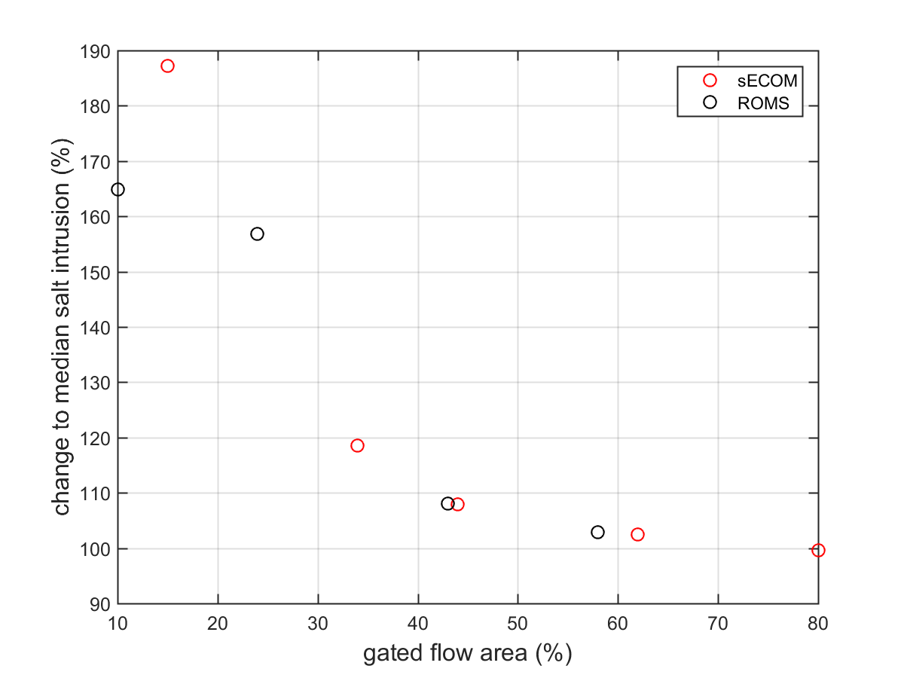

GFA vs Salt Intrusion Length (L)
Change based on ratio:
$100\left(\frac{L_{experiment}}{L_{control}}\right)$

Slide 39
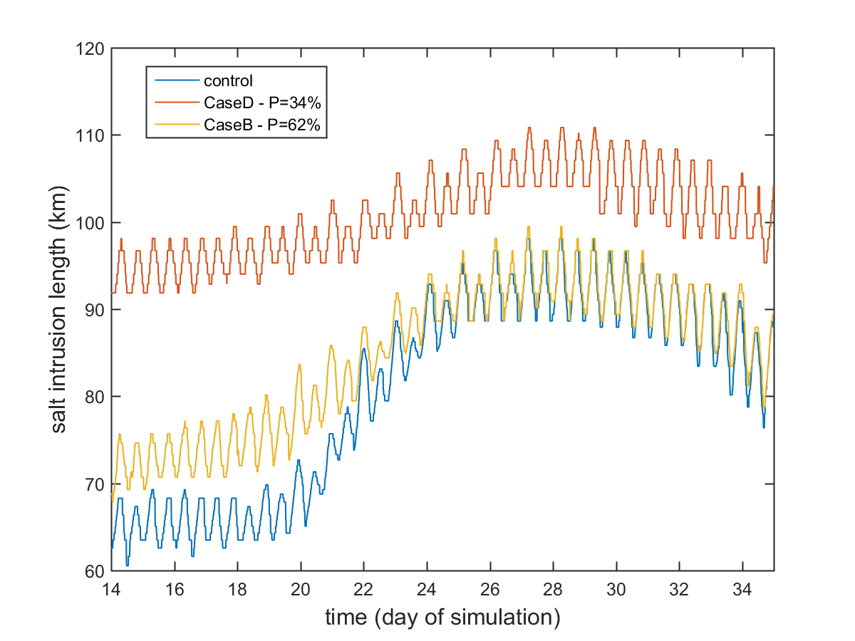
Salt Front Location (0.1 psu)
Poughkeepsie
GFA 34%
GFA 62%
Stronger stratification
longer salt intrusion
Lower neap-spring variability in stratification
→ Lower neap-spring variability in salt intrusion
salt intrusion length
(distance from Battery, km)
West Point
SPRING
NEAP
SPRING
All 3D simulations use annual average river streamflows

Slide 40
Physical Estuary Effects of Open Surge Barriers
The Hudson preliminary modeling and past studies provided consistent qualitative conclusions on the physical estuary effects of surge barriers
The degree of effects can be small or large – depends on openness of barrier
When a barrier system partially restricts estuary-ocean exchange
  It leads to stronger tidal currents and mixing near the barrier gate openings
  Elsewhere, on spring tides it causes reductions in tides, currents, mixing, and increases in stratification and salt intrusion
  For a partially mixed estuary, these changes lead to longer residence times at most locations
  However, for standing-wave estuaries or tide straits, different results may arise

Slide 41
EXTRA SLIDES

Slide 42
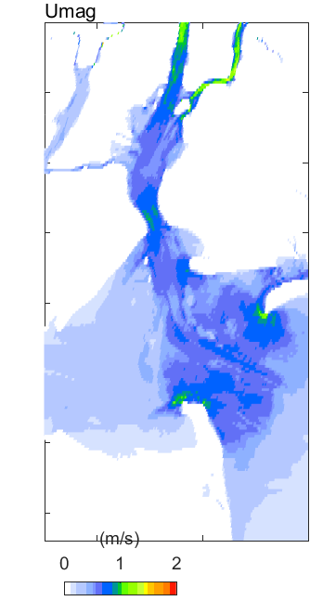
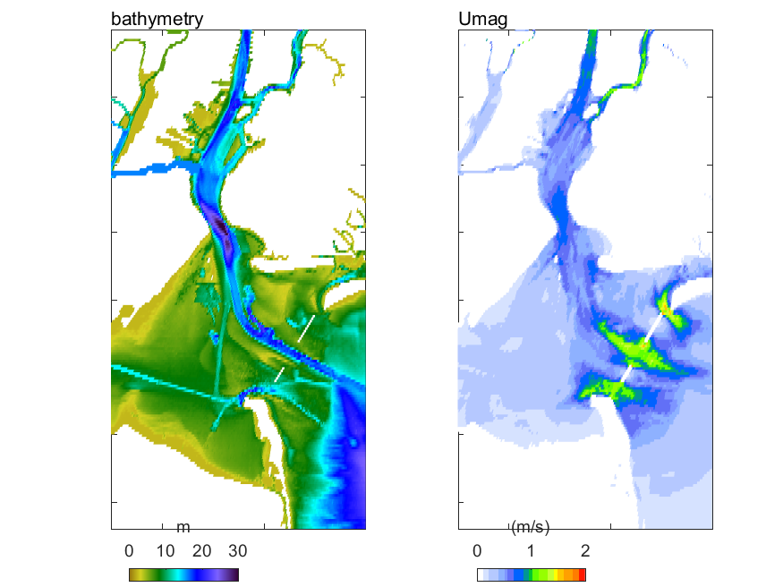
Woods Hole ROMS: max tidal velocity
Control
58% Gated Flow Area

Slide 43
sECOM/NYHOPS: bottom salinity
Control: GFA 100%
Battery water levels
Sal 1 psu

Slide 44
sECOM/NYHOPS: bottom salinity
GFA 62%
Battery water levels
Sal 1 psu

Slide 45
sECOM/NYHOPS: bottom salinity change (%)
Battery water levels

Slide 46
sECOM/NYHOPS: stratification (S_{bottom}- S_{surface})
Control: GFA 100%
Battery water levels
Sal 1 psu

Slide 47
sECOM/NYHOPS: stratification (S_{bottom}- S_{surface})
GFA 62%
Battery water levels
Sal 1 psu

Slide 48
sECOM/NYHOPS: stratification change (%)
Battery water levels

Slide 49
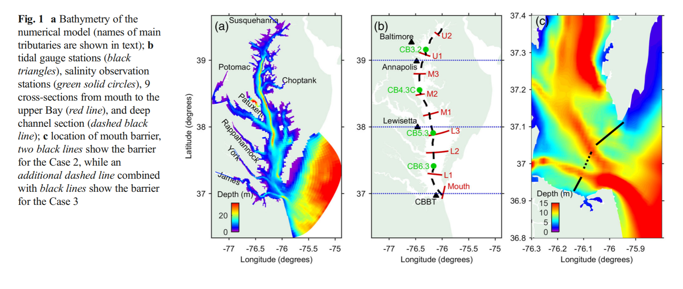
Modeling study on barriers in Chesapeake Bay
(Du et al., Estuaries and Coasts, 2017 )
Test effects of two barrier configurations: 15 km total length, 40% gated flow area
21 km length, 15% gated flow area
1
2
1
2
1

Slide 50
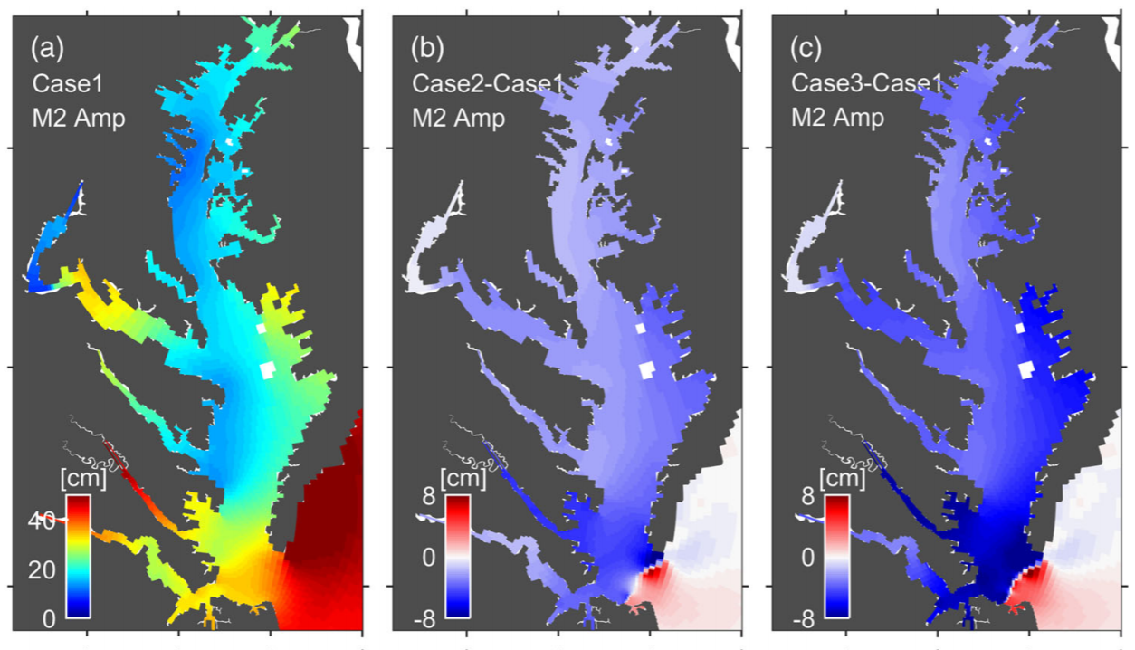
Modeling study on barriers in Chesapeake Bay
(Du et al., Estuaries and Coasts, 2017 )
Tidal amplitude decreased 13-20%, more so during spring tides
No barrier
Barrier 1
Barrier 2

Slide 51
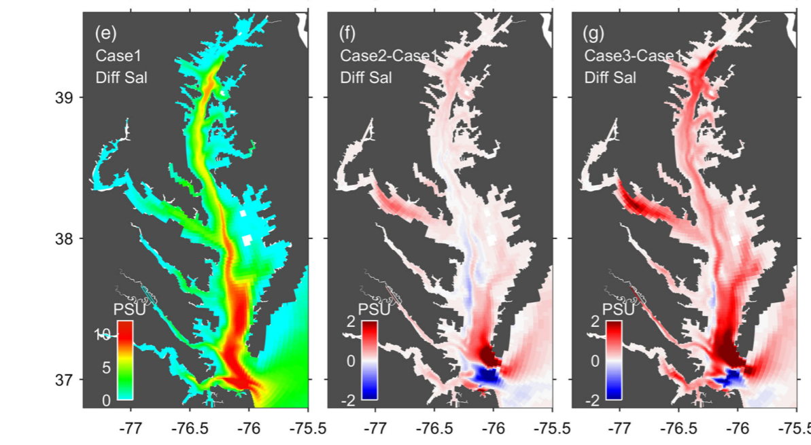
Modeling study on barriers in Chesapeake Bay
(Du et al., Estuaries and Coasts, 2017 )
Stratification and salinity intrusion increased, especially for lower gated flow area
Overall increase in stratification
No barrier
Barrier 1
Barrier 2
Decreased stratification in regions with increased tidal velocities

Slide 52
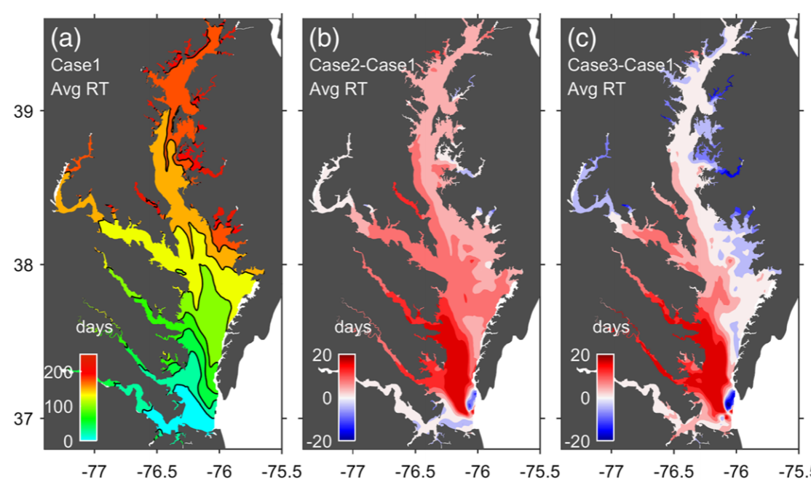
Modeling study on barriers in Chesapeake Bay
(Du et al., Estuaries and Coasts, 2017 )
Generally increased residence time and decreased vertical mixing (= more hypoxia) because of stronger stratification
No barrier
Barrier 1
Barrier 2
Some reductions in residence time where estuarine exchange dominates

Slide 53
Stakeholder Interests and Concerns
Identification of interests and concerns related to the potential environmental effects of surge barriers
Small group discussions, then report-outs
  What environmental components of the estuary are high priority to maintain or improve in the Hudson estuary?
  For which of these components are we most concerned about the potential effects of gates or barriers?

Slide 54
Near-Term Analyses within this Study
Summary of project team’s capabilities for near-term (next 4 months) scientific analysis, and discussion of draft Scope of Work of scientific analyses to be conducted under project
  Feedback on possible analyses within draft Scope of Work (additional possible? Priorities?)
  Are there other components of estuary health that we’ve discussed that should be modeled to inform the HAT Study? Which are possible in the near-term?

Slide 55
Near-Term Research for this Study
Research on physical influences of gated surge barriers on the Hudson and potentially also other parts of the New York/New Jersey Harbor estuary system will be performed at Stevens Institute of Technology under this study
The time available this spring/summer for this research is 3 months for a doctoral student and about 0.5 to 1.0 months for PI Orton
Work will need to be completed by November 2019 at the latest because this is a one-year project.

Slide 56
Overview of Present Research Capabilities
Analysis of changing historical physical conditions in model (1979-2019) or observational data
Statistical /frequency analysis of hazards resulting from high streamflows, tides, storm surge and waves
Modeling of estuary circulation, residence time, and water level under a very wide range of forcing conditions (e.g. storms, droughts, freshets, sea level rise) (e.g. NYHOPS; http://stevens.edu/nyhops).
However, the models available at Stevens do not have specially-designed high-resolution gridding around barriers and their gates, and without further model development these may give biased estimates of barrier effects (Orton & Ralston, 2018).

Slide 57
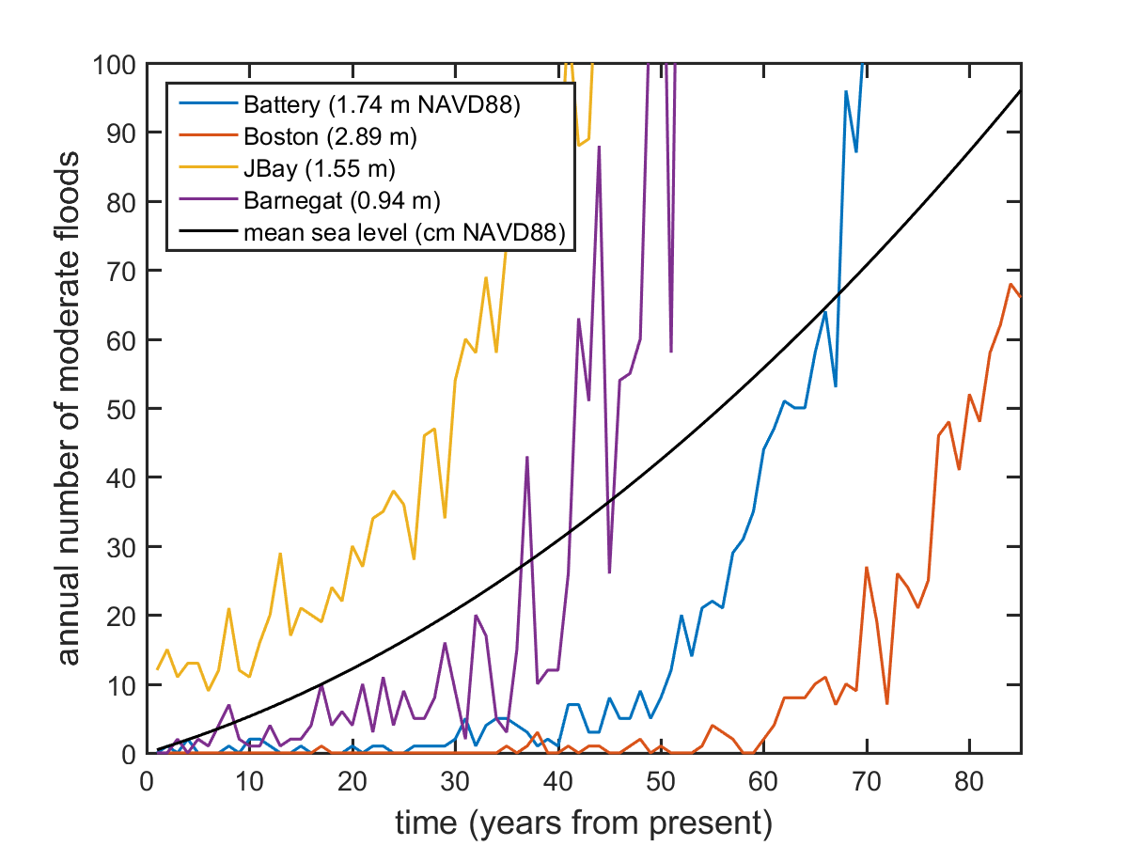
Possible Topic #1: Study gate closure frequency and its future evolution (10% effort)
Draft results
Rationale – The gate closure frequency strongly influences the effect of a surge barrier system on the enclosed estuaries.
The threshold for gate closure will typically depend on what shorefront residual risk reduction features exist.
Approach – Given an input of a threshold water level for neighborhood flooding, one can compute the number of expected events requiring closure per year for the present and also how this number changes with future sea level rise
Location (moderate flood threshold)

Slide 58
Possible Topic #2: Study duration of storm tides and gate closures (70%)
Rationale – the gate closure duration strongly influences the effect on the estuary during storms.
Draft analysis of historical surge durations
Approach –
analyze historical tide gauge data (see Figure)
analyze synthetic storm event data
perform joint extreme value probability analysis (e.g. copula modeling)
The latter two tasks would enable the analysis to include unusual events that are not reflected in our limited historical record.

Slide 59
Possible Topic #3: Assist the HAT Study (20%)
Help improve the science in the HAT Study by advising the Corps and its consultants with model development, risk assessment, dataset sharing, qualitative exploratory physical analyses, etc.
Approach – this is already occurring simply through our interactions, presentations and discussions.

Slide 60
Possible Topic #4: Assist the HAT Study with discovery-mode modeling (50% effort)
Rationale – our relatively comprehensive system knowledge can be used to explore and reveal important influences that may be overlooked in the complex NY/NJ Harbor estuary system.
Approach – A more comprehensive “discovery” mode could be used, wherein we use our existing models or deeper analyses of past simulations to identify possible additional Corps’ analyses – e.g. we could:
probe additional variables or processes
do a full preliminary examination of spatial variability in effects including the Hudson’s sub-estuaries
perform a process-study of gate closure phasing effects for NY/NJ Harbor and Throgs Neck
If important new topics are discovered, all the above could be added to the HATS study’s simulations this year

Slide 61
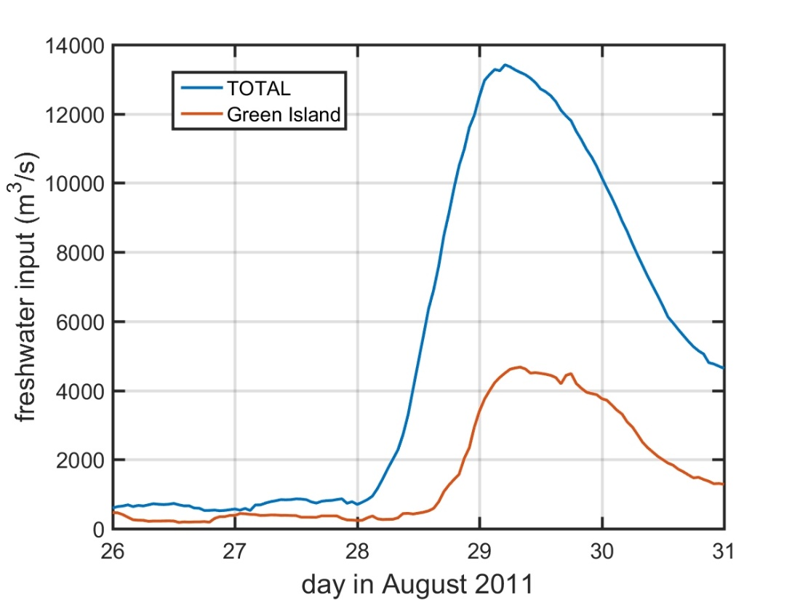
Possible Topic #5: Study the potential for trapped water river flooding (50%)
All figures or data from
Orton et al. (2012)
Rationale – high streamflow and storm surge often occur simultaneously in storms, and there may be some where there is a risk of flooding from surge and from rainwater or river freshet water behind closed barriers
Approach – Analyze our data to better understand this potential problem:
The NYHOPS estuary-ocean model is unique in level of freshwater forcing detail
We have pre-existing historical and synthetic storm data and probabilistic analysis datasets (Orton et al., 2018)
A longer-term study (one year) could create a probabilistic model of surge intensity, duration AND streamflow

Slide 62
Possible Topic #6: Quantify effects of changes to water levels and waves on marshes (50%)
Rationale – water level fluctuations during storms and waves strongly influence marsh sedimentation and edge erosion and should be quantified.
Approach –
Model effects of sea level rise and gate closures on water levels and waves along the Hudson
Compute various measures of wave forces on marshes such as “wave attack” (e.g., Tonelli et al., 2010)
(Leonardi et al. 2018)

Slide 63
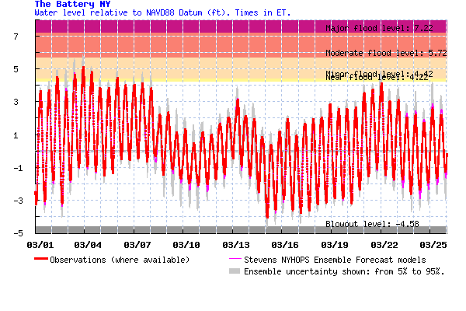
Possible Topic #7: Study how barrier gate closures influence estuary physical changes (80% effort)
Rationale – Periodic gate closure can also have an aggregate impact on estuary conditions, and this impact will increase if the frequency of closure increases with sea level rise. (Credit – Sam Hersh)
Approach – Simulate conditions causing a range of gate closure frequencies and durations (e.g. back-to-back nor’easters), then evaluate the influence on estuary conditions (mean, extreme).
A better understanding of the relationship between estuary changes and closure frequency could help the Corps work backward to an appropriate maximum frequency for gate closures, and on-shore residual risk/high frequency measures.

Slide 64
Possible Topic #8: Model water-quality related topics: pathogens or residence time (80%)
Rationale – Two concerns about surge barriers are (1) the impact on estuary residence time during normal open gate conditions, and (2) the impact on Combined Sewer Overflow pathogens during storm conditions with closed barriers.
Approach – We have experience with modeling for both topics in the harbor region (e.g., Marsooli et al., 2018; Wen et al., 2017). Depending on what analyses the HAT Study will undertake this year, we could do some additional modeling with our existing NYHOPS model that is complementary.
Notes:
(FYI - Based on the recommended criteria for Enterococci inrecreational waters, there should not be greater than a ten percentexcursion frequency of 110 cfu/100 mL in the same 30-day inter-val (USEPA, 2012). )

Slide 65
Possible Topic #9: Multi-model uncertainty/ ensemble analysis (>100%)
Rationale – a weakness of estuarine hydrodynamic models is their ability to accurately model stratification, and stratification is a critical factor for some of the more important effects of surge barriers (e.g. residence time).
Approach – repeat HAT Study analyses or Orton and Ralston (2018) model simulations and analyses as a method of quantifying modeling uncertainties.
Other institutions may have (or be developing) models that could be added to the ensemble. This would require additional funding for: (a) model development and validation, and (b) coordination and application of uniform forcing. Also, it may not be possible to complete this analysis before the end of 2019.
e.g., Warner et al. (2005) model study of the Hudson

Slide 66
Summary of Possible Near-Term Research Topics
Effort (%) Topic
10 1. Study gate closure frequency and its future evolution
70 2. Study duration (and intensity and probability) of storm tides and gate closures
20 3. Assist the HAT Study
50 4. Assist the HAT Study with discovery-mode modeling
50 5. Study the potential for trapped water river flooding
50 6. Quantify effects of changes to tides and waves on marshes
80 7. Study how barrier gate closures influence estuary physical changes
80 8a. Model water-quality related topics: residence time (open barriers)
80 8b. Model water-quality related topics: pathogens (closed barriers)
>100 9. Multi-model uncertainty/ensemble analysis (requires new models)
Inputs on these? Additional possible? Thoughts on priorities?
(Any higher-resolution modeling would require additional funding for model development and validation.)

Slide 67
Broadening to other Topics, Models, Analyses
Are there other components of estuary health that we’ve discussed that should be modeled or studied in the near-term to inform the HAT Study?

Slide 68
Near-Term Summer
Scientific Workshops
Presentation – briefly summarizing plans for holding workshops
Discussion
    Goals of the workshops
    Feedback on topics of interest for topic expert reports and long-term research
    Who are the appropriate experts to invite?

Slide 69
Summer Science Workshop Possibilities (1-2 of them)
We envision roughly 20 attendees, mainly scientists (we have funds to fly some in from elsewhere)
Should relate to estuary effects of surge barriers
Some initial ideas:
  Broad, all-day interdisciplinary workshop – using what we have learned about physical influences, expand to chemistry, ecology, biology, sediment
  Workshops on topics of greatest interest and need
  Goals of the workshops
    Produce topic expert reports to inform HATS present phase?
    Broaden research community and seek funding for long-term research?

Slide 70
Summer Science Workshop Possibilities (1-2 of them)
Discussion
    Goals of the workshops
    Feedback on topics of interest for topic expert reports and long-term research
    Who are the appropriate experts to invite?

Slide 71
Research Funding Needs and Opportunities
Identify needs and opportunities for leveraging or finding additional funding for conducting near-term or long-term priority research on estuary effects of surge barriers

Slide 72
Wrap-up, Next Steps
Review key discussion points and next steps

