Slide 1
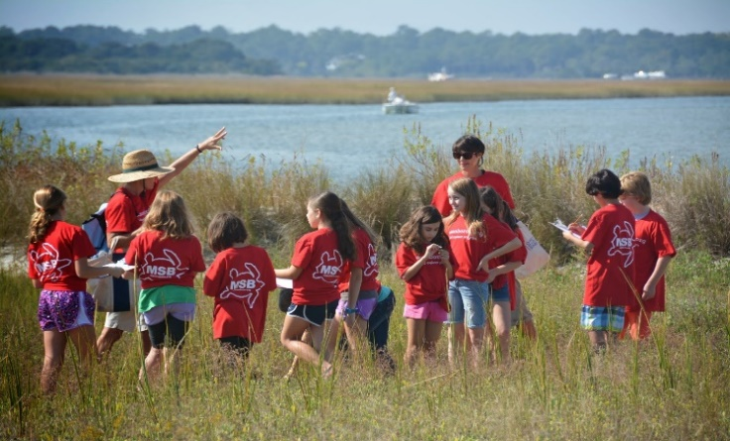
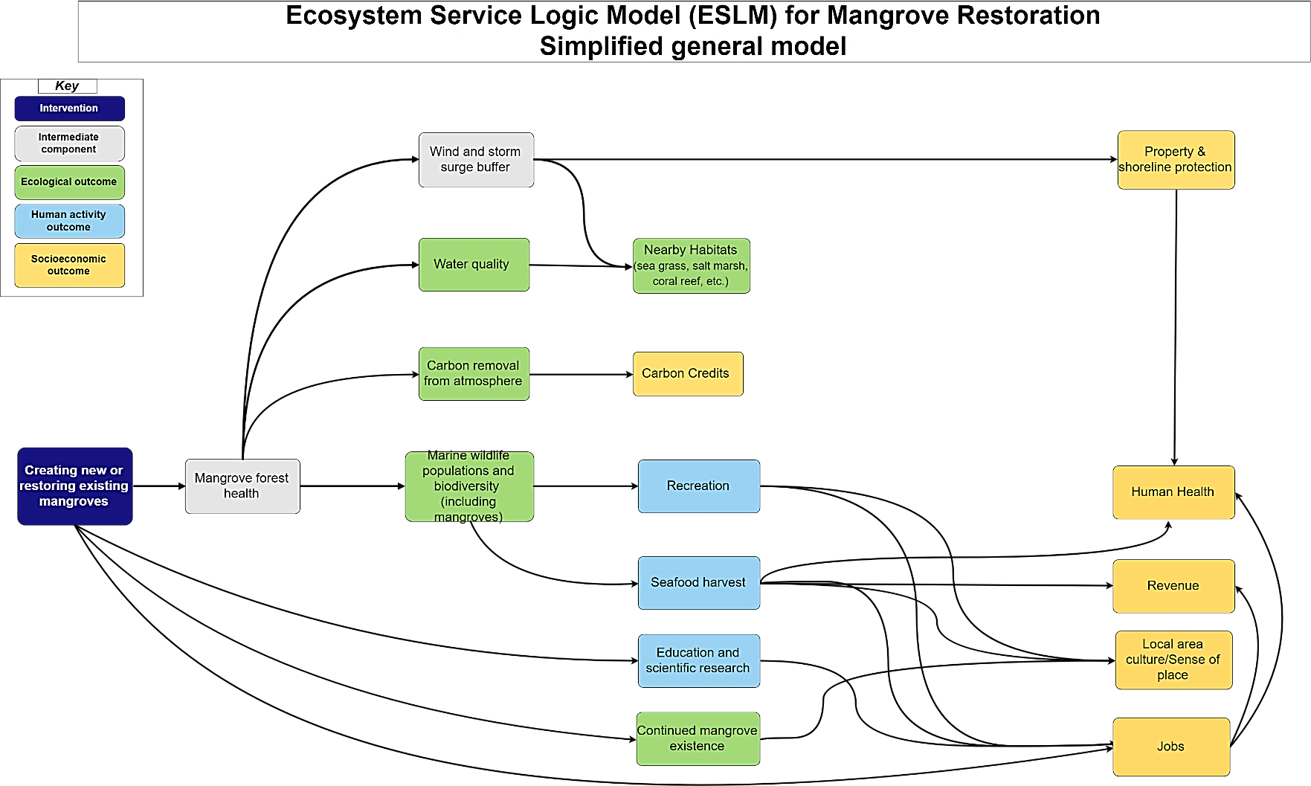
Ecosystem Services Concept Models for the NERRS
What are Ecosystem Service Concept Models? (ESCMs)
ESCMs are tool designed to support widespread implementation of ecosystem services in decision-making which can underpin both simple and complex methods while helping to improve consistency and credibility.
Graphically display the cascade of biophysical and ecological changes as well as how those changes can affect human well-being and social welfare (like jobs or displacement) based on an intervention (restoration or external stressor).
What can they be used for?
Models can be adapted to specific ecosystems (salt marsh, mangroves, oyster reef, etc.) and have the potential to improve consistency and credibility in assessing how management decisions and policies enhance, sustain, or degrade the benefits nature provides to people.
If a reference set of evidence-based conceptual models was established, they could become a go-to resource that provide efficiency and consistency in application. The development of such a repository would transition ecosystem services consideration from an interesting concept to an actionable approach to natural resource management.
Education activities taking place at Masonboro Reserve, part of the NC NERR.
http://nerrssciencecollaborative.org/project/Olander18
Notes:
what ESCMs are, what they can be used for, and why NERRS sites would want to use/ make them

Slide 2
Materials and Metrics
How are they helping the NERRS?
NERRS has been working over the past year to find streamlined ways to incorporate ecosystem services into agency decision-making, research, and management.
There has been a desire to better incorporate ecosystem services into NERRS management and stewardship both from the network as a whole (NERRS strategic plan), as well as at a local level (individual reserves and partners).
ESCMs will allow coastal managers to more easily identify and anticipate ecosystem service related outcomes of management interventions, provide an outreach tool to help stakeholders understand ecosystem services, and develop common ecosystem service metrics that would enable comparison across projects throughout the NERRS and beyond.
Products
Middle School Education Material | General Outreach Material
Introductory ES PowerPoint Lecture PowerPoint ES Team Game- Mangrove Mania and Oyster Reef Rally Printable Worksheets (outdoor optional) ES Bingo Service sorting | Stakeholder PowerPoint Presentations Twitter Infographics Adaptable Simplified ESCMs (Draw.io files) Short news/blog posts about the project ESCM Fact Sheet!
Metrics The results of a preliminary literature review and stakeholder workshops include a list of metrics that measure the dominant outcomes (e.g. outcomes that matter most to people). Stakeholders described many of these metrics as feasible to measure on NERRS sites and attributable to oyster reef restoration.
Outcome | Example Metric
Water Quality | Estimated filtration rate by oyster reef persistence Wastewater treatment capacity equivalent
Biodiversity | # of species at the site
Habitat Persistence | Size/extent of the site Rate of site loss per year in the region
Education/Scientific Opportunities | # of researchers using site/student opportunities # of papers/presentation on site # of grants awarded for site research
Property Damage/Value | Total value of flood damage # of properties w/ reduced erosion due to habitat Lifetime cost difference of hard vs. living shoreline
Culture | # of local restaurants selling local/farmed seafood (oysters)
Point your phone’s camera here for more information!
References
Mason, Sara, Lydia Olander, and Katie Warnell. 2018. “Ecosystem Services Conceptual Model Application: NOAA and NERRS Salt Marsh Habitat Restoration.” National Ecosystem Services Partnership Conceptual Model Series No. 3. Durham, NC: Duke University, Nicholas Institute for Environmental Policy Solutions. https://nicholasinstitute.duke.edu/conceptual-model-series.
Olander, Lydia, Sara Mason, Katie Warnell, and Heather Tallis. 2018. Building Ecosystem Services Conceptual Models. National Ecosystem Services Partnership Conceptual Model Series No. 1. Durham, NC: Duke University, Nicholas Institute for Environmental Policy Solutions. https://nicholasinstitute.duke.edu/conceptual-model-series.
Office for Coastal Management, National Estuarine Research Reserve System. 2018. “Exploring Applications of Ecosystem Services Conceptual Models for Coastal Habitats.” Factsheet. http://nerrssciencecollaborative.org/project/Olander18
http://nerrssciencecollaborative.org/project/Olander18

